Slide 1
Stay safe this Summer

Slide 2
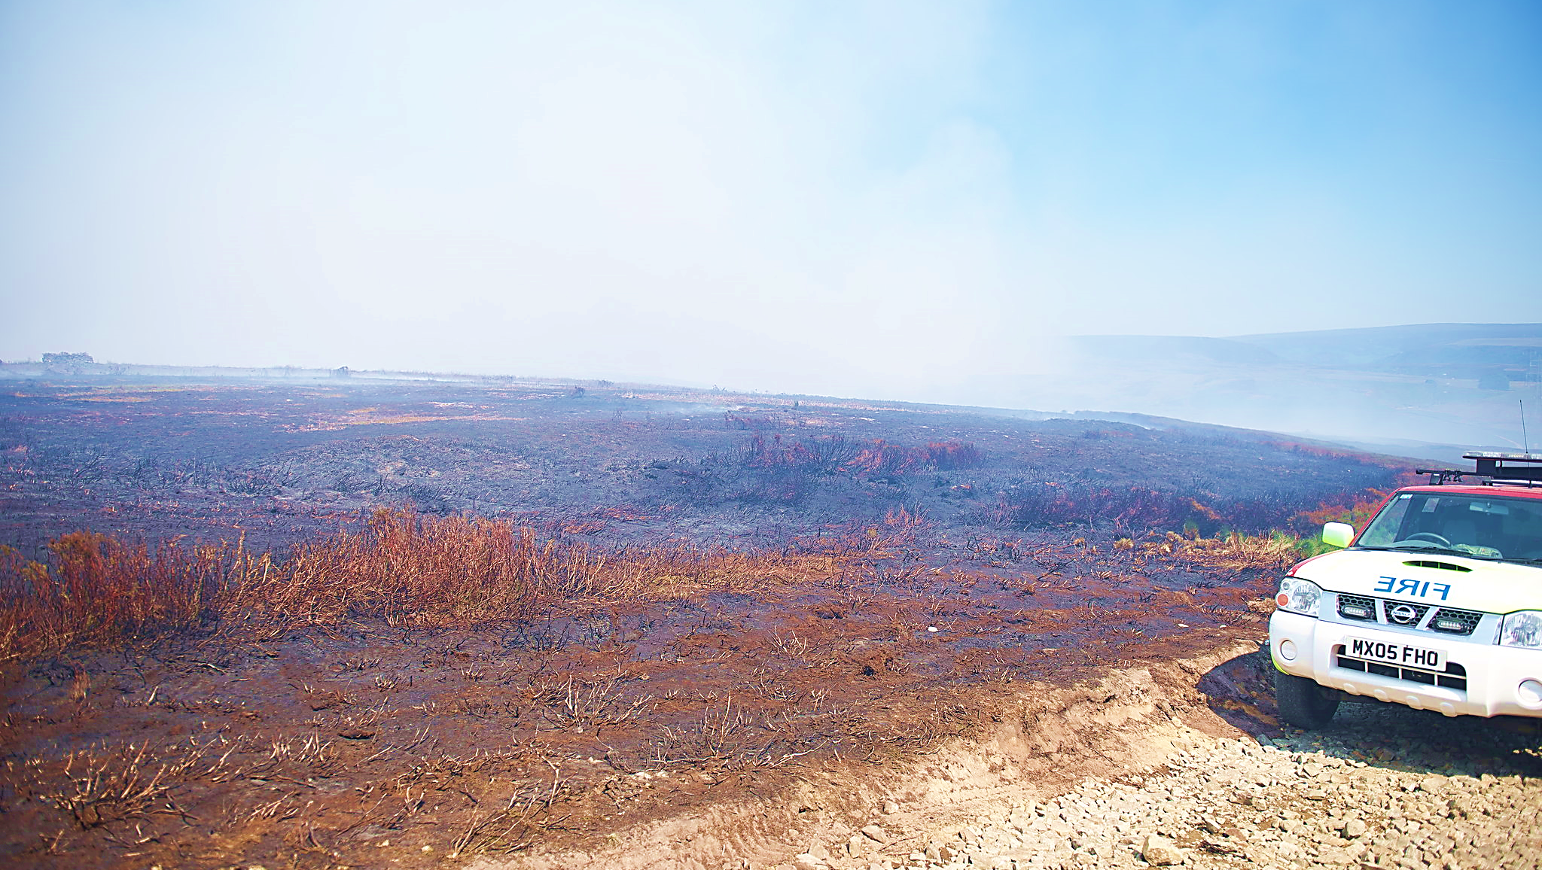
Grassfires and Moorland Fires

Slide 3
What causes Grassfires and Moorland Fires?

Slide 4
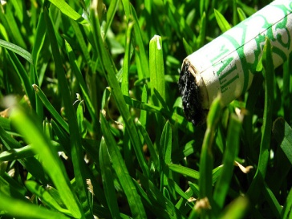
Cigarettes

Slide 5
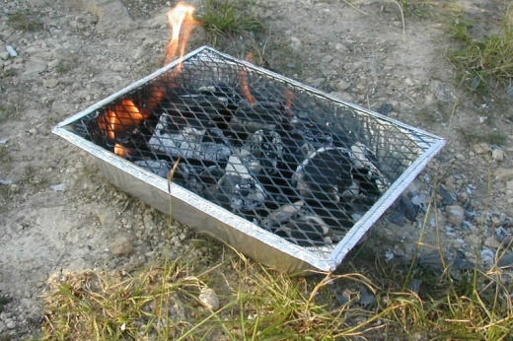
Barbeques

Slide 6
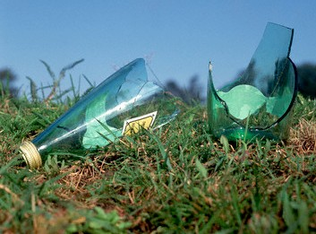
Litter

Slide 7
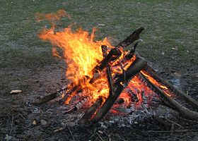
Camp Fires

Slide 8
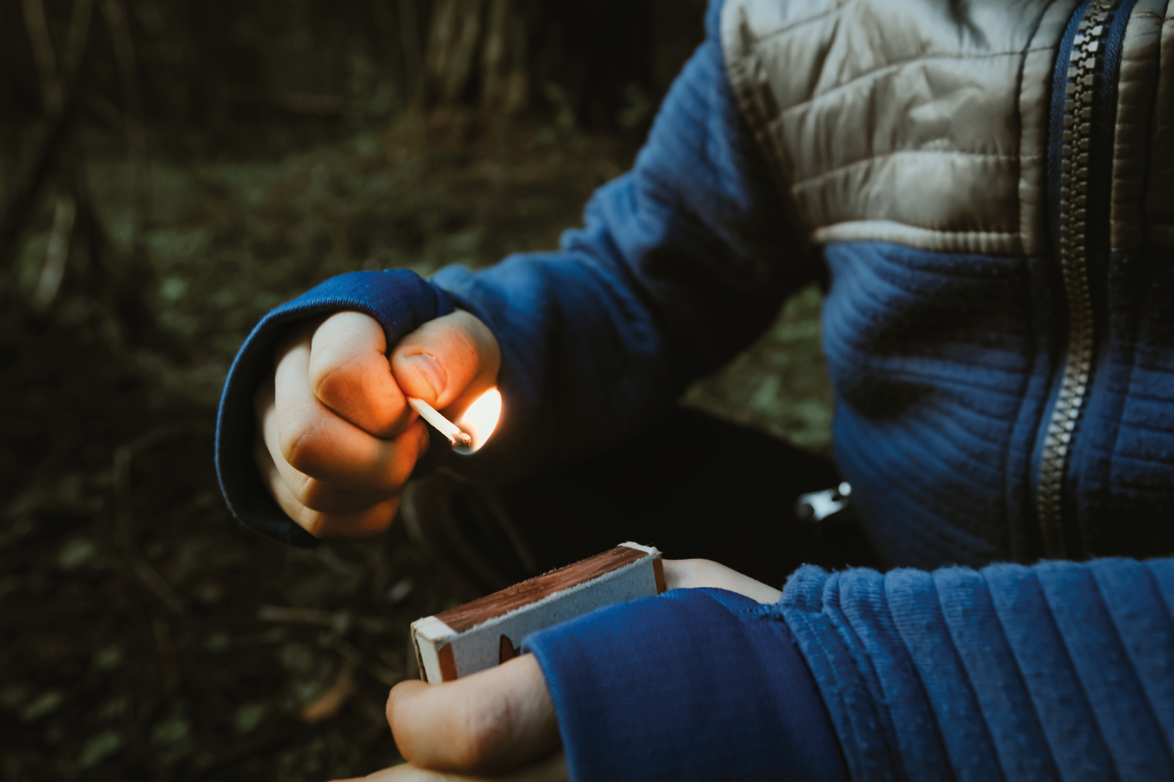
Anti-Social Behaviour

Slide 9
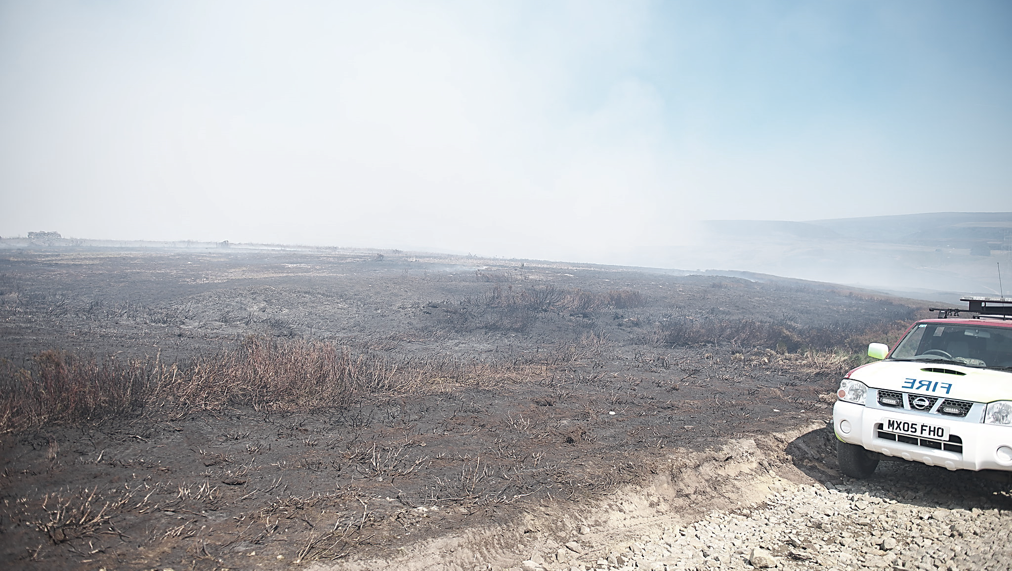
Preventing Grassfires and Moorland Fires
Cigarettes - If you are with adults who smoke remind them to extinguish cigarettes properly.
Litter - Please make sure that you take any rubbish home with you, especially glass.
Barbeques - Never light barbeques on moorland or dry areas. A fire can easily start and spread quickly, causing damage to the ground and wildlife.
Camp fires - Never light camp fires whilst on the moors. The ground is made of peat, which is highly flammable and it will catch fire and spread quickly.
ASB – Never deliberately set a fire on grass or moorland, anyone found guilty will be prosecuted and could face a heavy fine or even a prison sentence.

Slide 10
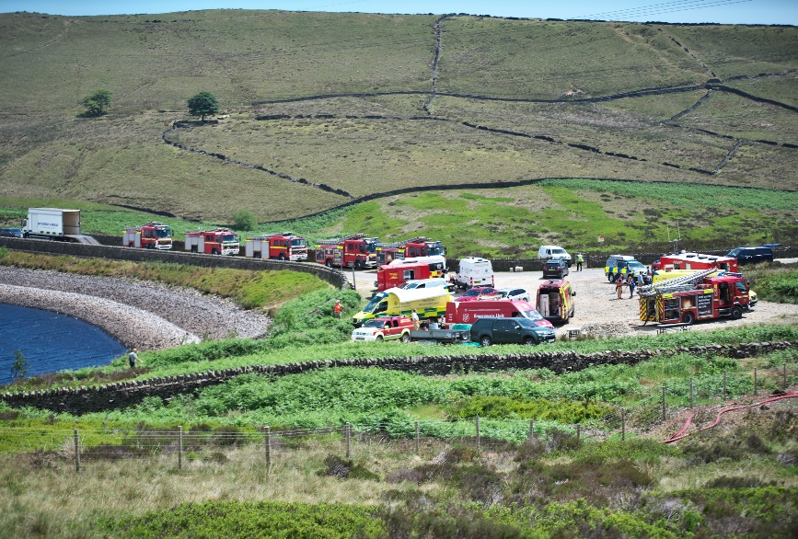
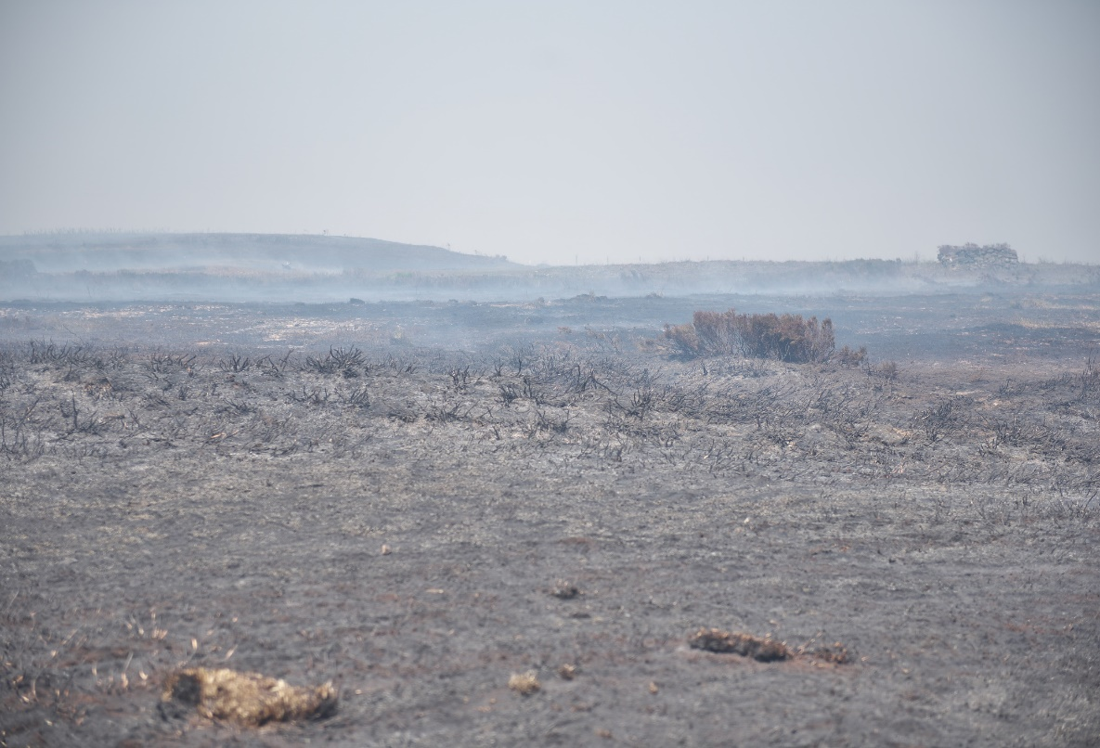
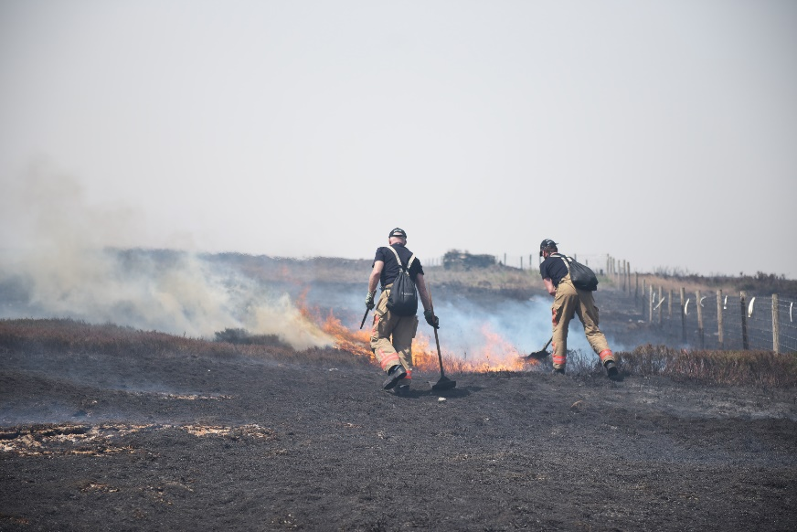
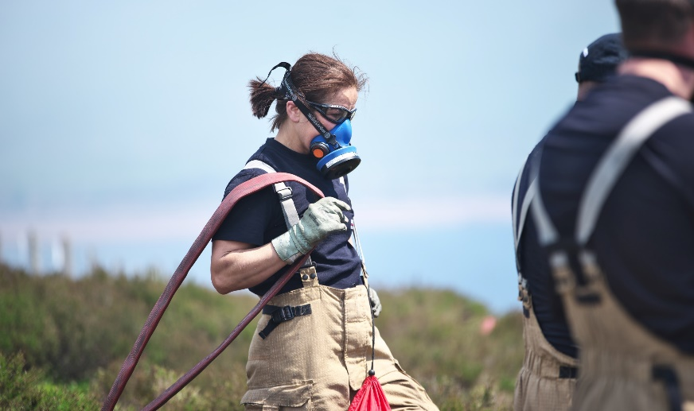
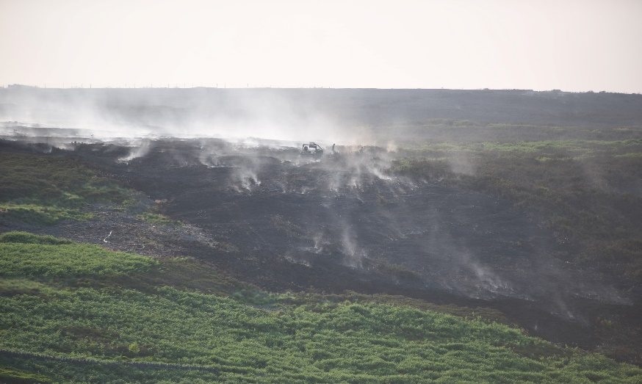
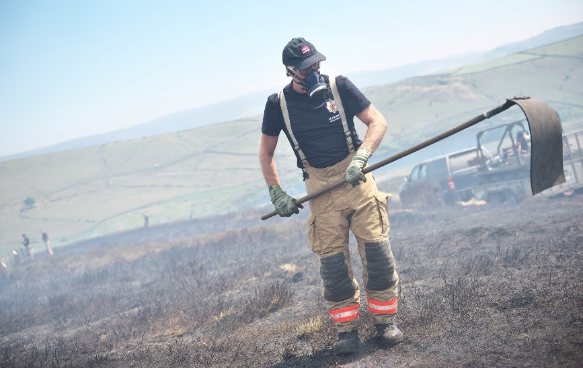
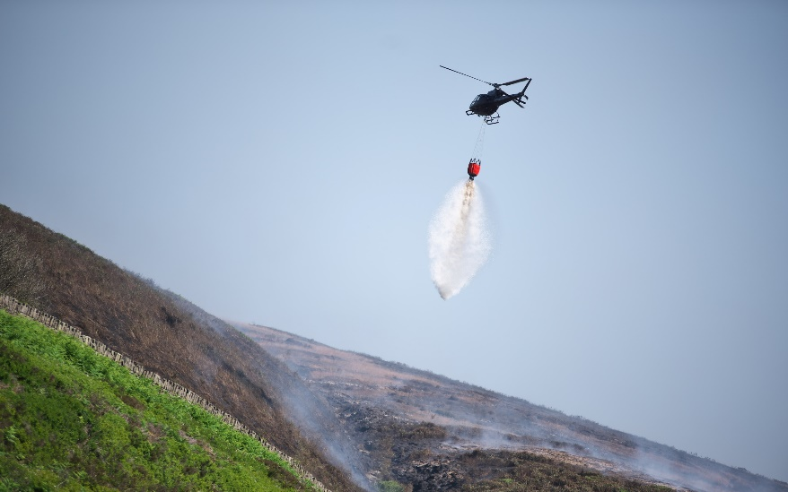
Moorland
Fires
Moorland
Fires

Slide 11
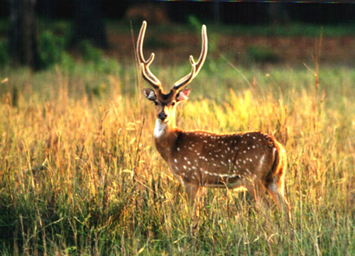
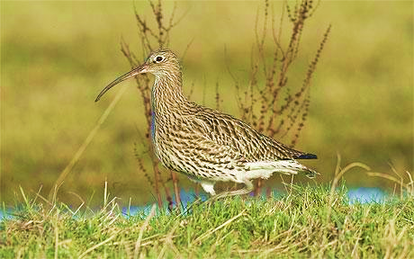
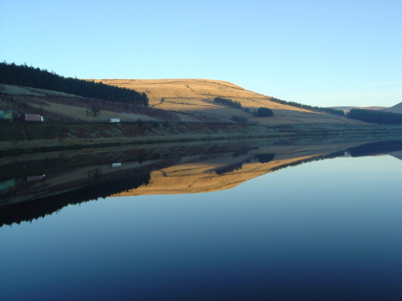
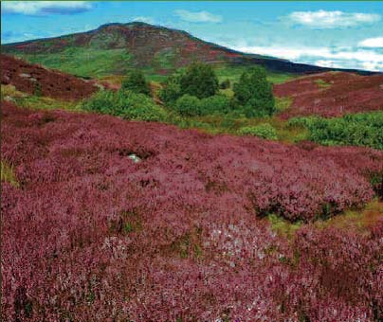
Damage caused by Grassfires and Moorland Fires
Animals
Birds
Drinking water
Plants

Slide 12
Time and Money
Fires are dangerous and unpredictable – they spread quickly and cause a huge amount of damage.

Slide 13
Information and Advice
Remember, if you see smoke or a fire in the countryside or on the moors call 999 immediately and ask for the Fire Service.
Tell the operator as much information as you can about your location.
Never attempt to tackle the fire yourself.

Slide 14
Please stay safe this Summer
Visit www.safe4summer.com

