Slide 1
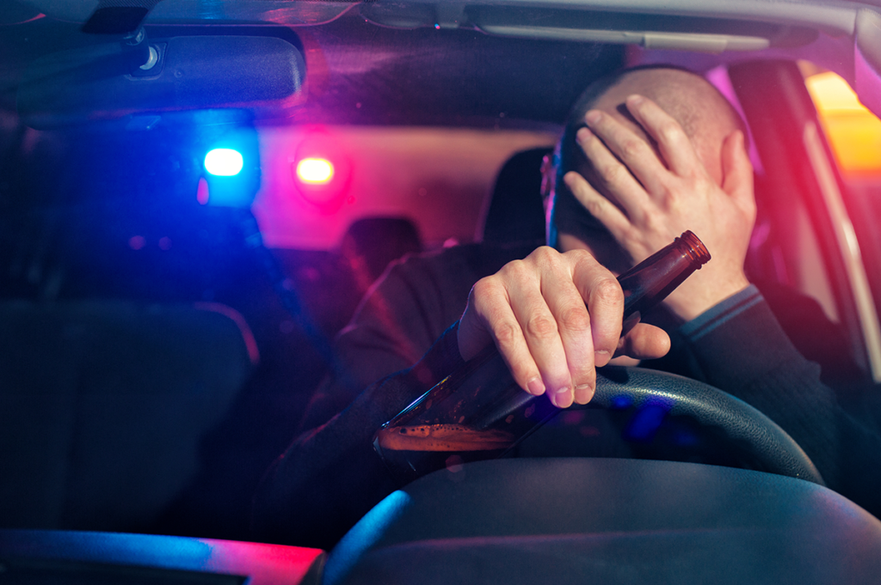
Road Safety
Drink & Drug Driving

Slide 2
Drink Driving
Over 200 people are killed and more than 1,100 seriously injured in drink drive crashes each year.
The legal drink drive limit is 80mg of alcohol per 100ml of blood.
Every year the police breath test over half a million drivers or riders and those who fail, face a 12 month ban and a large fine
However, the risk of crashing increases well below the legal limit. Drivers with a blood alcohol level between 20 mg/100 ml and 50 mg/100 ml are three times more likely to be killed in a crash than those who have no alcohol in their blood.

Slide 3
Drink and Driving
Alcohol impairs judgement, making drivers over-confident and more likely to take risks.
Alcohol is absorbed into the bloodstream very quickly, but it takes about an hour for 1 unit to be removed by a healthy liver.
Drinkers cannot be sure how much alcohol they are consuming because the alcoholic strength of drinks varies enormously, as does the size of measures.
Never rely on trying to calculate accurately how much alcohol is in your body, and whether you are above or below the drink drive limit.
Remember, you may still be over the limit the next morning after drinking the night before!

Slide 4
The Film Karen’s Story We are going to show you a film about the consequences of drink and drug driving. Some viewers may find this distressing.

Slide 5
Film Karen’s Story
Notes:
Transcript available on the Lesson Plan

Slide 6
Drink and Driving Penalties
It’s an offence to drive, attempt to drive, or be in charge of a motor vehicle on a road or public place.
You could be imprisoned, banned from driving and face a fine if you’re found guilty of drink-driving.
In addition to these penalties are the everyday consequences of being caught drink driving which can include
Job loss.
Increase in car insurance costs.
Trouble getting in to countries like the USA.
The shame of having a criminal record.
Loss of independence.

Slide 7
Drink Driving Consequences
Could you live with the guilt of causing injury or death to other people, even children???
Many drunk drivers live with life changing injuries when they have crashed. Don’t let this be you.

Slide 8
Drugs and Driving

Slide 9
Drugs and Driving
Almost 100 people are killed each year in accidents involving drivers who were impaired by illegal drugs or medicines)
Did you know a new drug drive law came into force in England and Wales in March 2015 and made it an offence to drive, attempt to drive, or be in charge of a motor vehicle
The law sets very low limits for eight illegal drugs, such as cannabis, cocaine, ecstasy and ketamine, so taking even a very small amount could put a person over the limit.

Slide 10
The affects of illegal drugs
Slower reactions. Poor concentration – Aggression.
Confused thinking - Erratic behaviour.
Distorted perception - Blurred vision.
Over confidence, resulting in taking unnecessary risks.
Poor co-ordination - Severe fatigue the following day.
Tremors - Panic attacks or paranoia.
Dizziness - Cramps.

Slide 11
Drugs and Driving More reasons to be paranoid
Notes:
Transcript is available on the Lesson Plan

Slide 12
Drugs Prescribed or otherwise
Zero Tolerance for people taking illegal drugs and driving.
A roadside 'drugalyser' test for cannabis and cocaine is used by the Police
If you’re taking any of the specified 'medicinal' drugs don't stop taking your medicines.
If you're not sure if you’re safe to drive, check with your pharmacist or doctor.
Follow the advice of a healthcare professional and read the accompanying leaflet.

Slide 13
Thank you Any Questions?
Drink & Drug Driving

