Slide 1
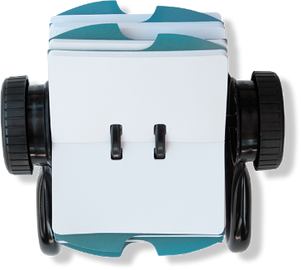
What can you do to make sure this doesn't happen to you?
Remember bonfires and fireworks are dangerous
Have a safe time during the Halloween and Bonfire period.
To see the firework code and for a chance to win an ipad go to: www.safe4autumn.com
Never put yourselves in situations that may be dangerous
Think about the consequences of what could happen
Think how you and others may be affected
The Incident:
Name:
Danny Jones, age 14.
Cause of incident:
Aerosol thrown into bonfire.
Injuries sustained:
Serious burns to facial area. Potential damage to eyes. Hospitalised for treatment.
Danny Jones
Incident date: 5th November
What were Danny and his friends thinking at the time?
Who has been affected by the incident?
How have they been affected?

Slide 2
The Incident:
Name:
Danny Jones, age 14.
Cause of incident:
Aerosol thrown into bonfire.
Injuries sustained:
Serious burns to facial area. Potential damage to eyes. Hospitalised for treatment.

Slide 3
Danny Jones
Incident date: 5th November
What were Danny and his friends thinking at the time?
Who has been affected by the incident?
The Incident:
Name:
Danny Jones , age 14.
Cause of incident:
Aerosol thrown into bonfire.
Injuries sustained:
Serious burns to facial area.
Potential damage to eyes.
Hospitalized for treatment.
How have they been affected?

Slide 4
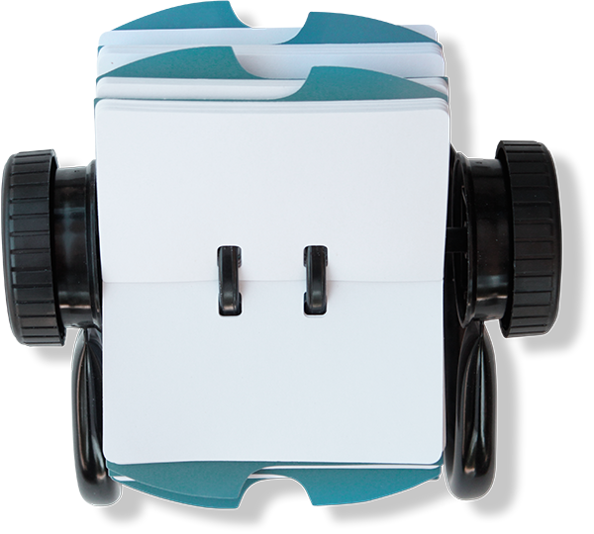
What can you do to make sure this doesn't happen to you?
The Incident:
Name:
Danny Jones, age 14.
Cause of incident:
Aerosol thrown into bonfire.
Injuries sustained:
Serious burns to facial area. Potential damage to eyes. Hospitalised for treatment.
Danny Jones
Incident date: 5th November
What were Danny and his friends thinking at the time?
Who has been affected by the incident?
How have they been affected?

Slide 5
Never put yourselves in situations that may be dangerous
Think about the consequences of what could happen
Think how you and others may be affected
What can you do to make sure this doesn't happen to you?
The Incident:
Name:
Danny Jones, age 14.
Cause of incident:
Aerosol thrown into bonfire.
Injuries sustained:
Serious burns to facial area. Potential damage to eyes. Hospitalised for treatment.
Danny Jones
Incident date: 5th November
What were Danny and his friends thinking at the time?
Who has been affected by the incident?
How have they been affected?

Slide 6
Remember bonfires and fireworks are dangerous
What can you do to make sure this doesn't happen to you?
The Incident:
Name:
Danny Jones, age 14.
Cause of incident:
Aerosol thrown into bonfire.
Injuries sustained:
Serious burns to facial area. Potential damage to eyes. Hospitalised for treatment.
Danny Jones
Incident date: 5th November
What were Danny and his friends thinking at the time?
Who has been affected by the incident?
How have they been affected?

Slide 7
Have a safe time during the Halloween and Bonfire period.
To see the firework code and for a chance to win an ipad go to:
www.safe4autumn.com
What can you do to make sure this doesn't happen to you?
Remember bonfires and fireworks are dangerous
Never put yourselves in situations that may be dangerous
Think about the consequences of what could happen
Think how you and others may be affected
The Incident:
Name:
Danny Jones, age 14.
Cause of incident:
Aerosol thrown into bonfire.
Injuries sustained:
Serious burns to facial area. Potential damage to eyes. Hospitalised for treatment.
Danny Jones
Incident date: 5th November
What were Danny and his friends thinking at the time?
Who has been affected by the incident?
How have they been affected?

Slide 8
What can you do to make sure this doesn't happen to you?
Remember bonfires and fireworks are dangerous
Have a safe time during the Halloween and Bonfire period.
To see the firework code and for a chance to win an ipad go to: www.safe4autumn.com
Never put yourselves in situations that may be dangerous
Think about the consequences of what could happen
Think how you and others may be affected
The Incident:
Name:
Danny Jones, age 14.
Cause of incident:
Aerosol thrown into bonfire.
Injuries sustained:
Serious burns to facial area. Potential damage to eyes. Hospitalised for treatment.
Danny Jones
Incident date: 5th November
What were Danny and his friends thinking at the time?
Who has been affected by the incident?
How have they been affected?

Slide 9
What can you do to make sure this doesn't happen to you?
Remember bonfires and fireworks are dangerous
Follow us:
Greater
Manchester
Fire and
Rescue
Service
Have a safe time during the Halloween and Bonfire period.
To see the firework code and for a chance to win an ipad go to: www.safe4autumn.com
Never put yourselves in situations that may be dangerous
Think about the consequences of what could happen
Think how you and others may be affected
The Incident:
Name:
Danny Jones, age 14.
Cause of incident:
Aerosol thrown into bonfire.
Injuries sustained:
Serious burns to facial area. Potential damage to eyes. Hospitalised for treatment.
Danny Jones
Incident date: 5th November
What were Danny and his friends thinking at the time?
Who has been affected by the incident?
How have they been affected?

Slide 10
What can you do to make sure this doesn't happen to you?
Remember bonfires and fireworks are dangerous
Have a safe time during the Halloween and Bonfire period.
To see the firework code and for a chance to win an ipad go to: www.safe4autumn.com
Never put yourselves in situations that may be dangerous
Think about the consequences of what could happen
Think how you and others may be affected
The Incident:
Name:
Danny Jones, age 14.
Cause of incident:
Aerosol thrown into bonfire.
Injuries sustained:
Serious burns to facial area. Potential damage to eyes. Hospitalised for treatment.
Danny Jones
Incident date: 5th November
@manchesterfire
What were Danny and his friends thinking at the time?
Who has been affected by the incident?
How have they been affected?

Slide 11
What can you do to make sure this doesn't happen to you?
Remember bonfires and fireworks are dangerous
Have a safe time during the Halloween and Bonfire period.
To see the firework code and for a chance to win an ipad go to: www.safe4autumn.com
Never put yourselves in situations that may be dangerous
Think about the consequences of what could happen
Think how you and others may be affected
The Incident:
Name:
Danny Jones, age 14.
Cause of incident:
Aerosol thrown into bonfire.
Injuries sustained:
Serious burns to facial area. Potential damage to eyes. Hospitalised for treatment.
Danny Jones
Incident date: 5th November
What were Danny and his friends thinking at the time?
Who has been affected by the incident?
How have they been affected?

