Slide 1
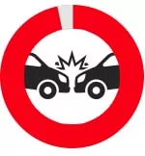
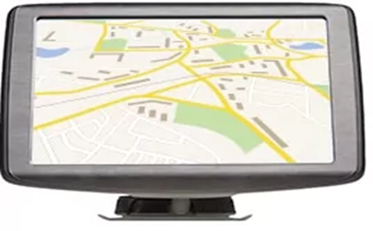
Distraction
Road Safety

Slide 2
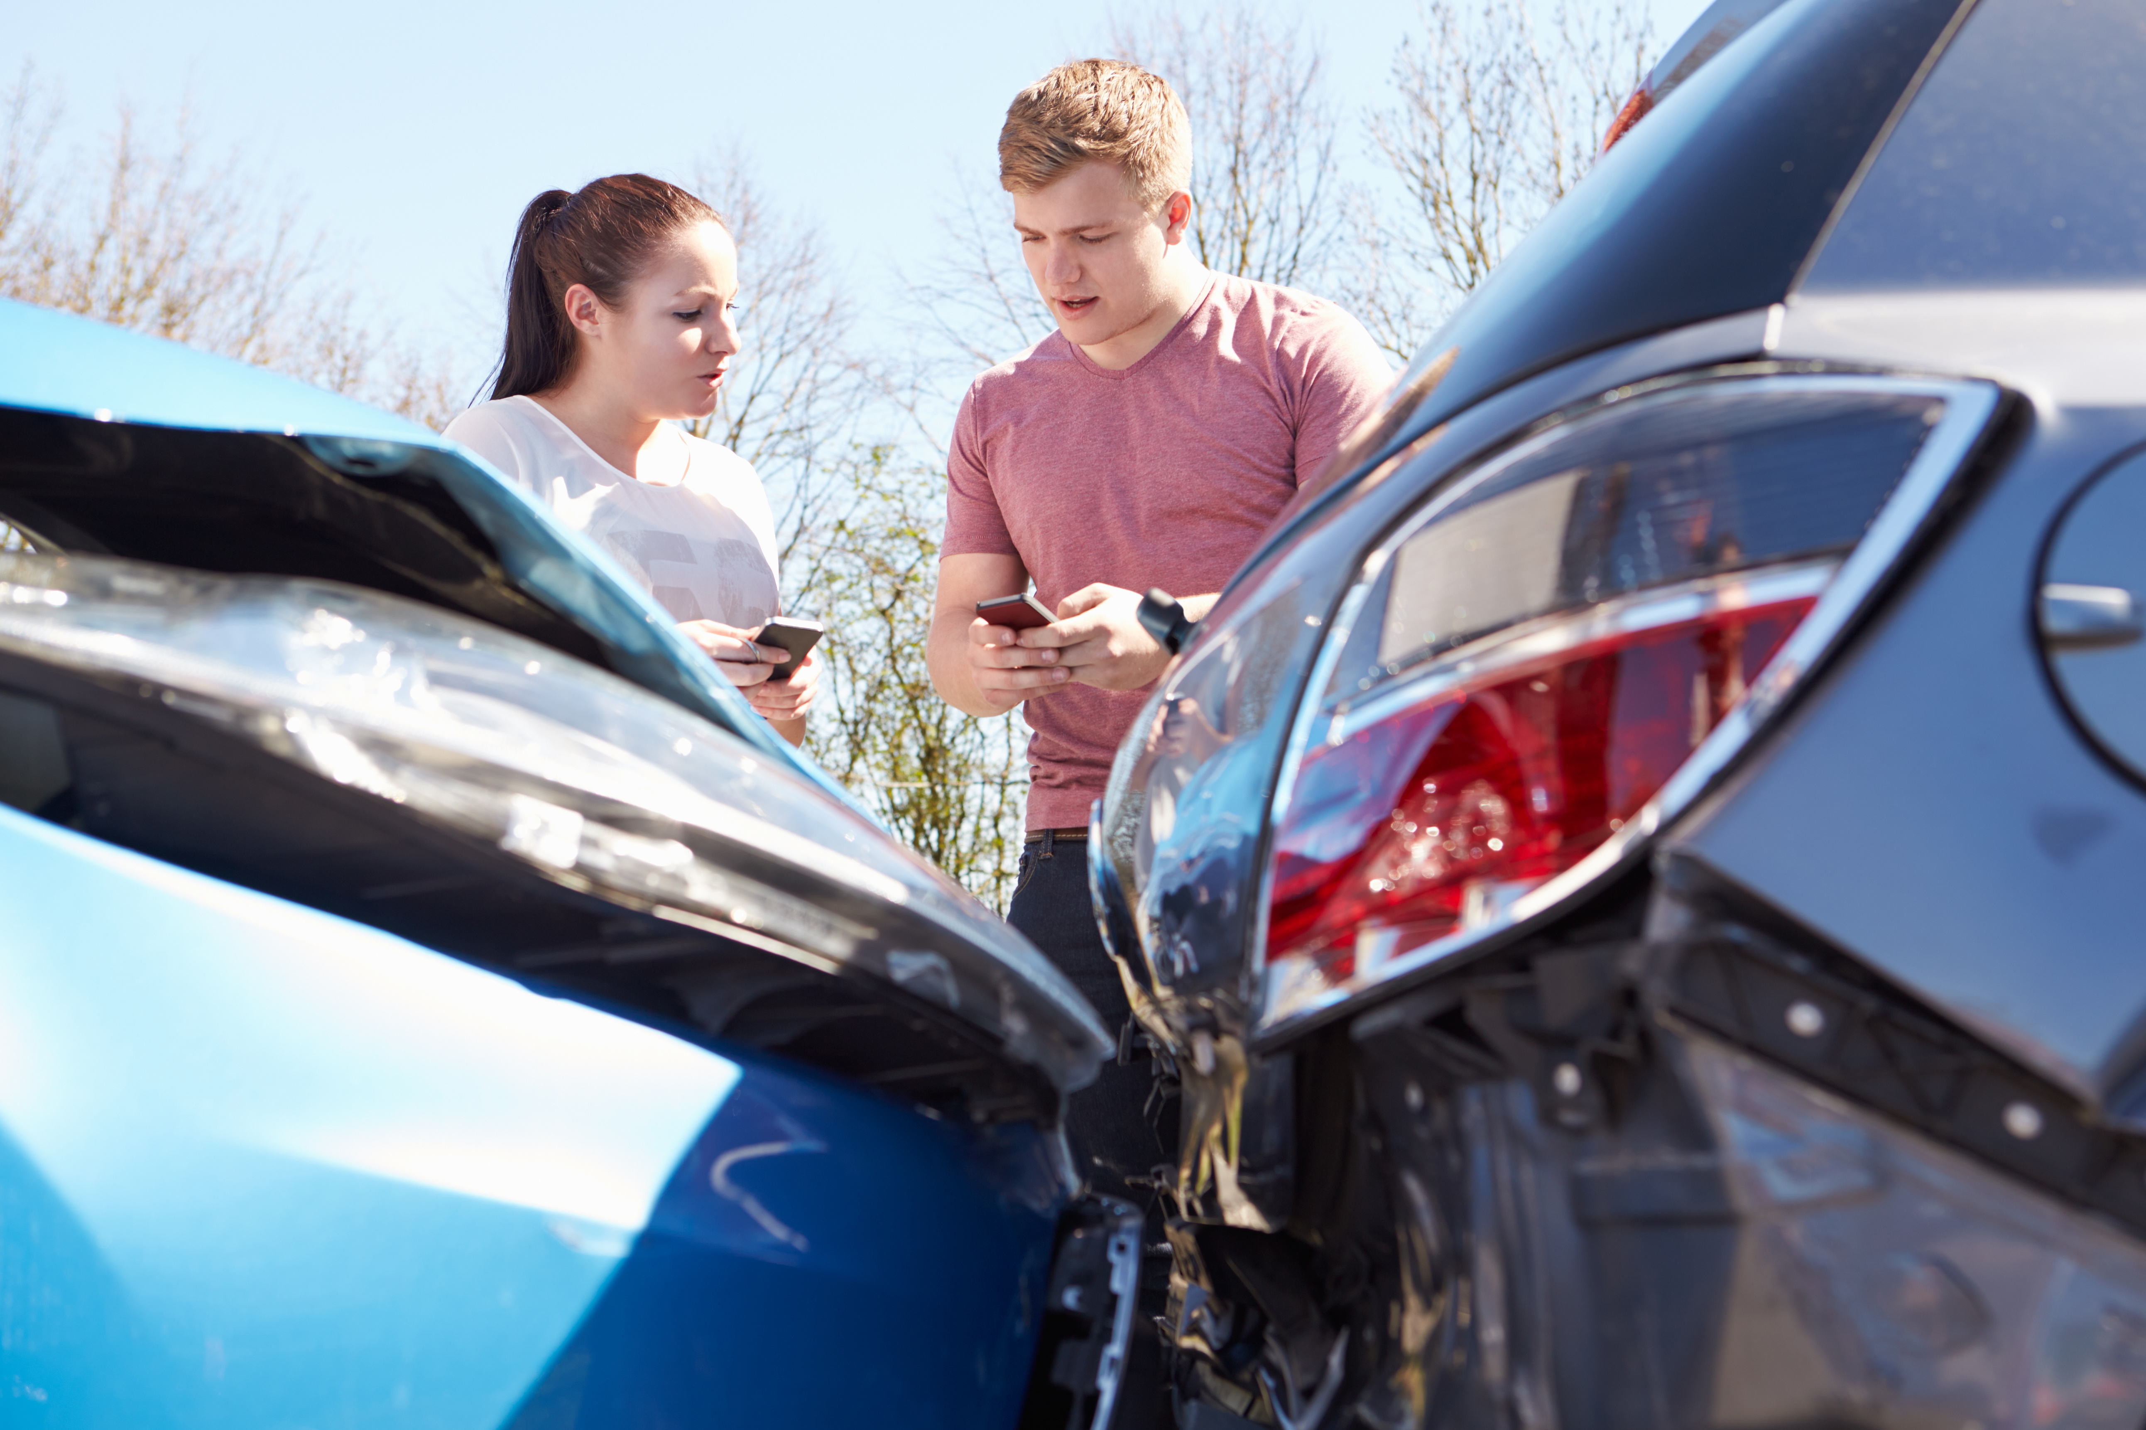
Road Safety Distraction
Young males aged 17-24 are four times more likely to be killed or seriously injured compared with car drivers aged 25 or over.
Young male drivers are more likely to crash with passengers in the car.
The ‘Party Car Campaign’, (THINK! – Road safety). Is aimed at tackling driving distractions among this high-risk group.
The campaign encourages passengers to ‘let a mate concentrate’.
The films show how certain behaviours which may seem minor, can be distracting to the driver.

Slide 3
Our Party Car - Distraction
Notes:
Transcript is available on the Lesson Plan

Slide 4
Different types of driving distractions
Manual distractions cause the driver to take one or both hands from the wheel.
Similar to visual, but will lead to the driver’s attention being drawn away.
These distractions will lead to the driver’s eyes being taken away from the road.

Slide 5
Distraction
There are simple things you can do to make sure there’s nothing to distract you whilst driving. Prepare yourself and your car before starting your journey.
Clear out clutter
Fully charge your Sat Nav and programme before you start your journey
Pre-set the radio or play lists before setting off
Send any texts or make calls, then pop your phone in the glove box.

Slide 6
The facts … using a mobile phone hand - held or hands free. Drivers are…
Much less aware of what’s happening on the road around them.
Fail to see road signs.
Fail to maintain proper lane position and steady speed.
Are more likely to ‘tailgate’ the vehicle in front.
React more slowly, take longer to brake and longer to stop.
Are more likely to enter unsafe gaps in traffic.
Feel more stressed and frustrated.

Slide 7
The current penalties for using a mobile phone while driving are…
A fixed-penalty notice, a £200 fine and six penalty points for using a handheld phone when driving.
New drivers who have passed their test in the past two years will automatically lose their licence.
If taken to court, you could face disqualification and a fine of up to £1,000 (£2,500 if you’re driving a lorry or a bus).
Ask yourself… Could you live with the guilt if you caused injuries or death by using a phone, sat nav, tablet, or any device that can send or receive data, whilst driving or riding a motorcycle?

Slide 8
Staying clear-headed whilst you’re on the road
Keep calm and focussed
If you have something on your mind, try to deal with it as much as possible before getting behind the wheel.
Try not to drive if you're feeling overwhelmed or stressed
If you need to make a call or send a text, wait until you've pulled over safely to use your phone.
Even if you're feeling stressed, resist the urge to smoke, vape or eat while you're driving.

Slide 9
Would you distract your friend…
Notes:
Transcript is available on the Lesson Plan

Slide 10
Staying focused with passengers in the car….
Passengers of all ages can be a distraction - from teething toddlers to overexcited friends.
Kids squabbling or arguing in the back is another big distraction for drivers too!
Make sure children are securely strapped into car seats and booster seats.
If you're driving with one young child, it can be less distracting for the child to ride in the front seat (in a suitable restraint) because casual eye contact is easier.

Slide 11
Staying focused while you have passengers in the car….
If there are two adults in the car, one can look after any children whilst the other concentrates on driving.
Ask passengers to keep the music at a level where you can hear the sat nav and other drivers around you.
If you're finding the drive difficult, ask your passengers to keep conversations to a minimum.
Keep political discussions and any other heated topics strictly off-limits.

Slide 12
Driving safely with Pets in the car
There are ways of keeping your pet safe in the car, but if your pet is playing up during the drive, how can you stay calm and collected?
Secure your pet properly
Pull over safely when dealing with your pet

Slide 13
Distraction
BE ATTENTIVE
The key to driving is to ensure you’re always alert and attentive to what’s going on around you. As such, distractions can hamper your ability on the road. If an incident occurs ahead and you’re too busy changing the radio station, you might not be able to avoid a collision. Therefore, you need to make sure every second on the road is spent being fully attentive.

Slide 14
Be mindful of everything
Some motorists have tunnel vision, only watching what’s going on directly in front of them.
This isn’t ideal though, because hazards can be present everywhere.
Make sure to pay attention to the whole road and be better prepared to avoid hazards when driving.

Slide 15
Remember the two second gap
When driving, particularly on motorways and at high speeds, ensure to leave a lengthy gap between you and the car in front.
This should be around two seconds (or two chevrons if they’re painted onto the road).
In wet or icy conditions, you’ll need to leave a longer distance.

Slide 16
Road Safety Distraction
D Distraction is a killer.
I It’s your responsibility.
S Stay Safe.
T Take your time.
R Ring before you start to drive not during.
A Always, let a mate concentrate.
C Could you live with your conscience?
T Text then pop your phone in the glove box.
I If your passengers are distracting you, pull over safely and stop the car.
O Observe others using the roads inside and outside of the vehicle.
N Never drive when eating, drinking or reading.

Slide 17
Thankyou Any Questions?
Road Safety Distraction

